Slide 1


Spectral Analysis Of Lungs Sounds For Classification Of Asthma And Pneumonia Wheezing
Community of Research & Development – CRD
Researchpedia
University of Engineering and Technology,
Taxila, Pakistan

Slide 2
MOTIVATION

Slide 3

235 million suffer from
Asthma.
450 million suffer from
Pneumonia.
1 billion people
suffer from chronic respiratory diseases worldwide
3 million people die each year from Pulmonic diseases.

Slide 4
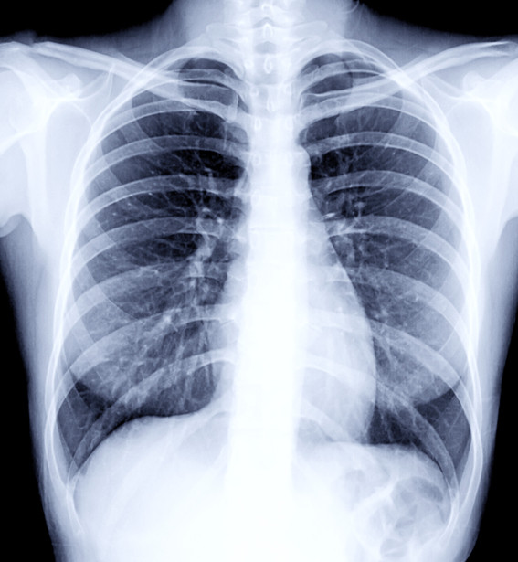
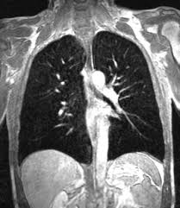
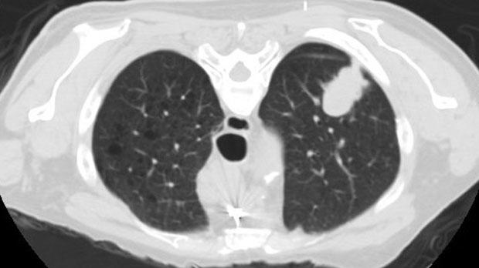
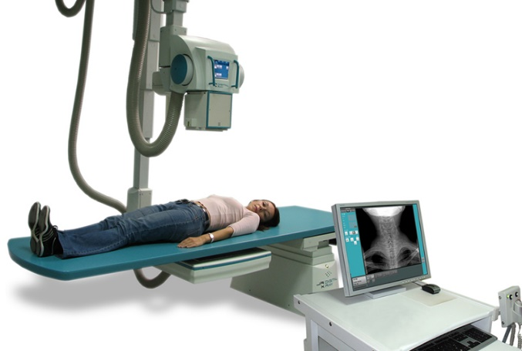
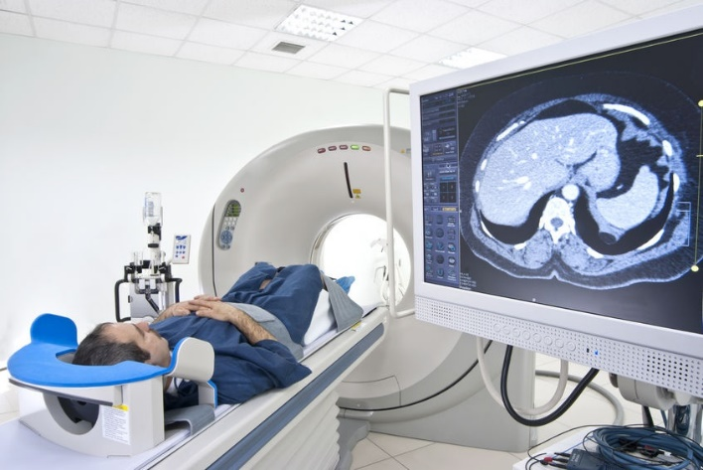
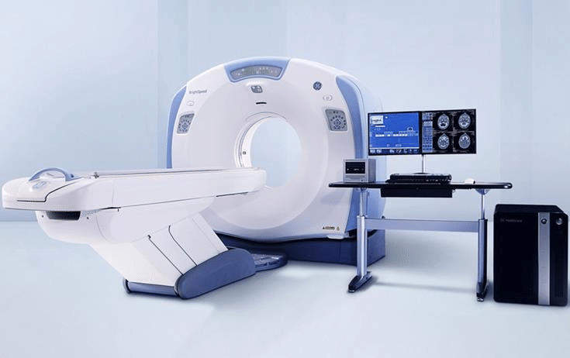
Various techniques for the diagnostic of pulmonary issues are quite expensive and their results come after quite some time .
X-Ray
Magnetic Resonance Imaging
Computed Tomography Scan

Slide 5
INTRODUCTION

Slide 6
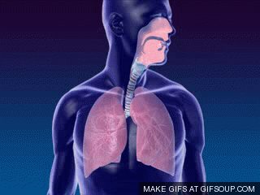
Lung Sounds
Lung sounds come from the lungs when you breathe in and out.
These sounds can be heard using a stethoscope or simply when breathing.
1
2
Normal Lung Sounds
Abnormal Lung Sounds
A normal lung sound is similar to the sound of air.
There are two normal lung sounds.
Bronchial breathing
Vesicular breathing
Adventitious lung sounds are abnormal sounds that are heard over a patient's lungs and airways.
These sounds include abnormal sounds such as;
Crackles
Wheezes
Rhonchi
Pleural rubs
Stridor.

Slide 7
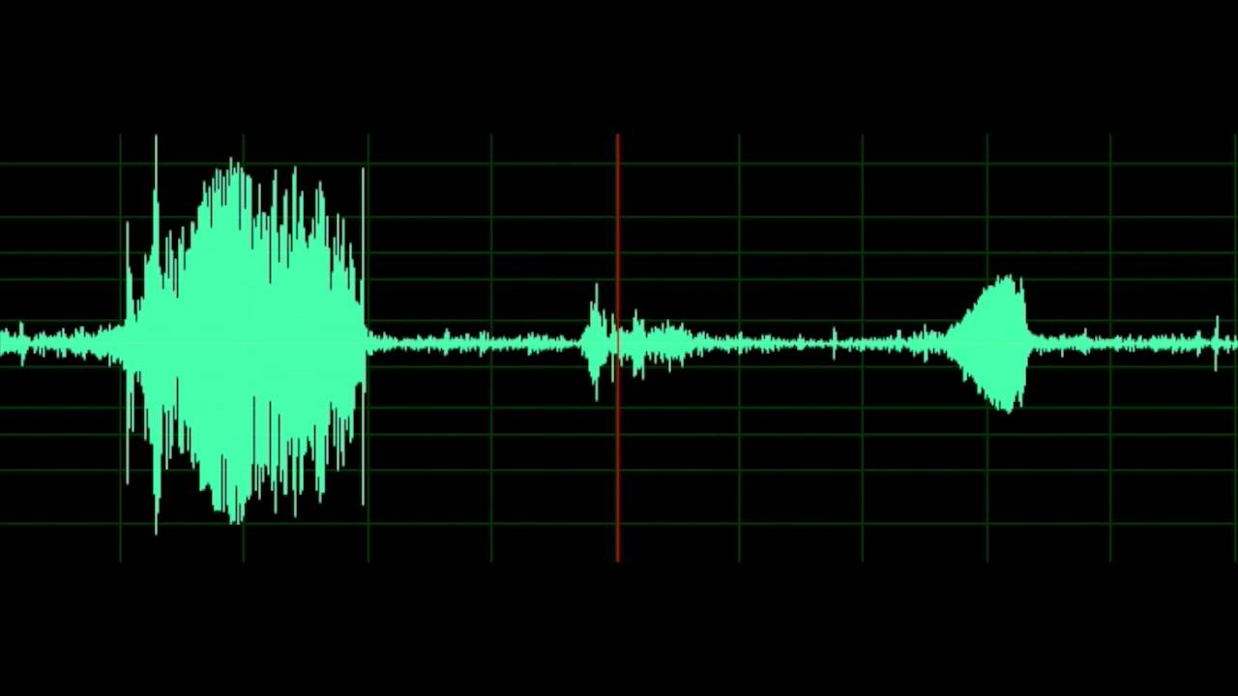
Wheezing
Wheeze is a continuous, coarse, whistling sound produced in the respiratory airways during breathing.
Wheezing occurs respiratory tree must is narrowed or obstructed or airflow velocity within the respiratory tree is heightened.
Common cause of wheezing is asthma attacks, pneumonia, COPD, lung cancer, congestive heart failure.

Slide 8

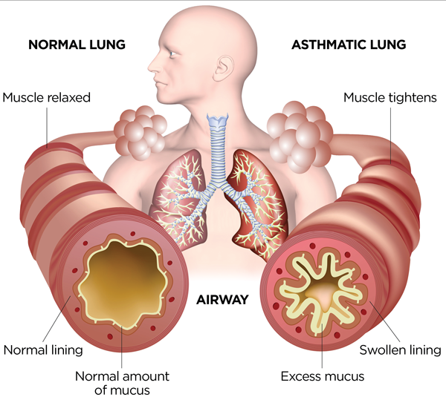
Asthma
Asthma is a condition in which your airways narrow and swell and produce extra mucus.
Symptoms
01
02
03
Trouble sleeping caused by shortness of breath, coughing or wheezing
Causes production of wheezing sounds,
Difficulty in breathing as well as hypersensitivity towards irritants.
Shortness of breath
Chest tightness or pain

Slide 9
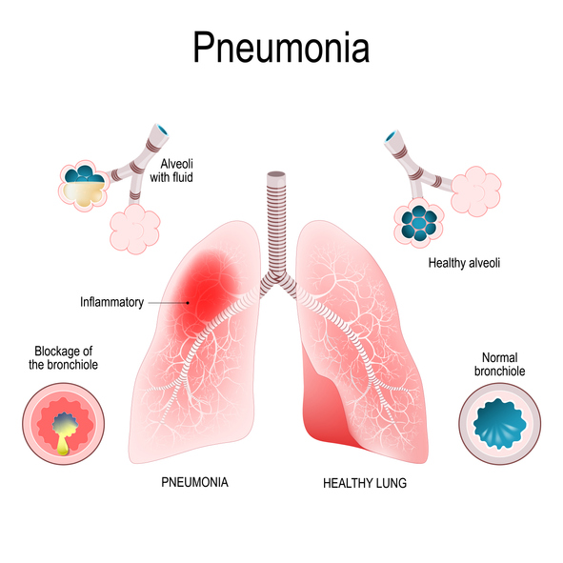
Pneumonia
Symptoms
Pneumonia is an infection that inflames your lungs' air sacs (alveoli). The air sacs may fill up with fluid or pus.
Wheeze or Cough, which may produce greenish, yellow or even bloody mucus
Fever, sweating and shaking chills
Sharp or stabbing chest pain that gets worse when you breathe deeply or cough
Loss of appetite, low energy, and fatigue
Nausea and vomiting, especially in small children

Slide 10
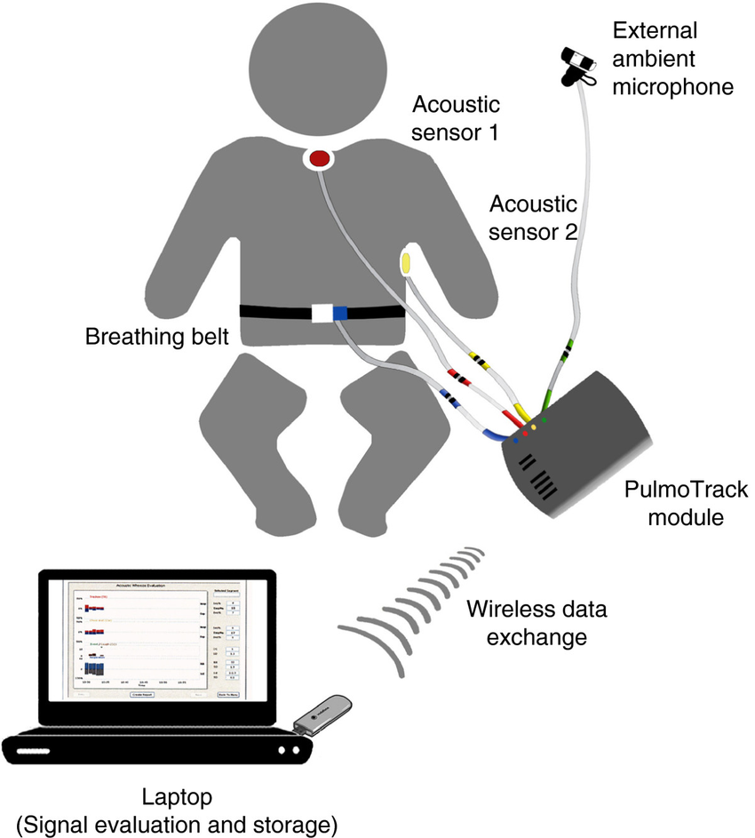
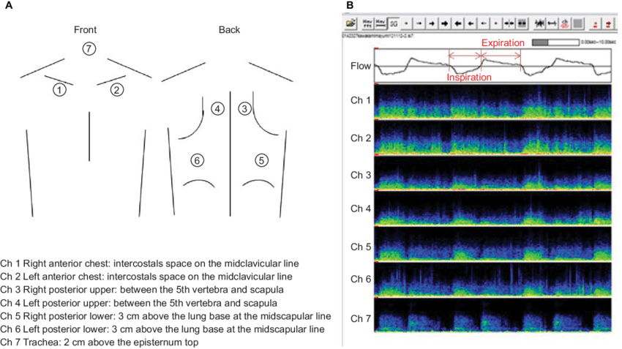
Lung Sound Analysis
Recording the patient's lung sounds via an electronic device.
Computer analysis.
Classification of lung sounds based on specific signal characteristics.
No incision and radiation required.

Slide 11
LITERATURE REVIEW

Slide 12
2015
Lung Sounds (Asthma Wheeze, Normal)
BPNN
94.6% [2]
01
02
2016
Lung Sounds (Wheeze, Normal)
MFCC , SVM
92% [3]
2019
Lung Sounds (Monophonic Wheeze, Polyphonic Wheeze, Normal)
Mel-frequency Cepstrum, Dyadic Discrete Wavelet Transform, peak energy ratio, EML, SVM, KNN
82.9% , 86% [6]
05
03
2017
Lung Sounds (Normal, Wheeze, Rhonchi, Line ,Coarse Crackles)
ARC, MFCC , SVM
88.72% , 89.68% [4]
04
2018
Lung Sounds (Asthma Wheeze, Normal)
STFT, Hidden Markov Model
94.91% [5]
.

Slide 13
MATERIALS AND METHODS

Slide 14
Proposed Methodology Of System
PRE-PROCESSING
Normalization
Segmentation
Filtration
CLASSIFICATION
Support Vector Machine.
1
3
2
4
DATA ACQUISITION
Collection of Wheezing Lung sounds from Asthmatic and Pneumonia Patients.
Collection of Normal Lung sounds from Healthy individuals.
FEATURE EXTRACTION
Spectral domain features.

Slide 15

Data Acquisition Setup
STEP 01
STEP 02
Sound card
Mic and mouthpiece
Breathing signal
Mic and mouthpiece
System
STEP 03
Sound recording
Sound card reader
Importing data
PC/ laptop

Slide 16

Data Set
Signal acquired through the nostrils of subjects.
Data collected from various hospitals.
Time duration: 10 sec/subject.
Fs: 44.1kHz
Saved as .wav
Sr. No. | Class | Gender* | Age (Years) | No. of Samples
1. | Asthma | 40F,60M | 12-47 | 1000
2. | Pneumonia | 50F, 50M | 28-67 | 1000
3. | Normal | 50F, 50M | 27-69 | 1000
*M: Male, F: Female

Slide 17
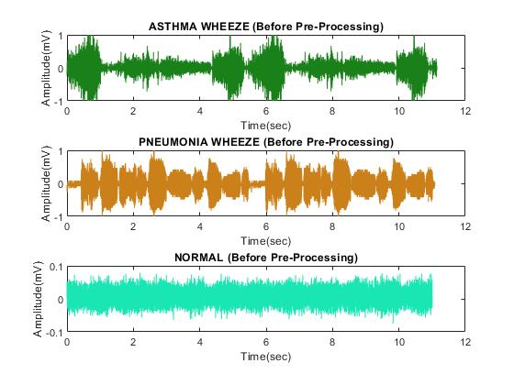
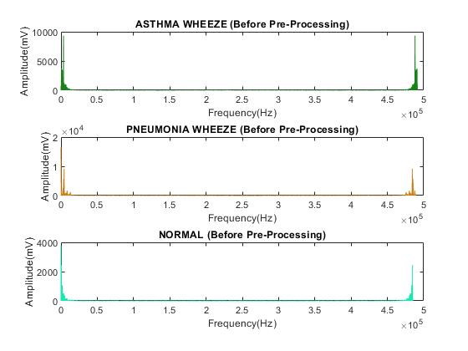
Raw Lung Signal Before Pre-processing
Frequency Domain Representation
Time Domain Representation

Slide 18
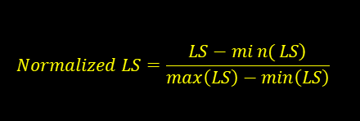
Pre-processing
Normalization
Removes un-necessary artefacts
Reduces the time complexity for training and classification.
Min-Max method is adopted for normalization.
01
$$Normalized LS=\frac{\left.LS−min{(}LS\right)}{\max\left(LS\right)−\min\left(LS\right)}$$
ii. Segmentation
Signal is sectioned into 250 ms frames to remove the non-breathing and silent parts.
02
iii. Filtration
Butterworth bandpass filter of tenth order with a sampling frequency of 44.1 kHz is designed.
Range lies from 250 Hz to 2000 Hz.
03

Slide 19
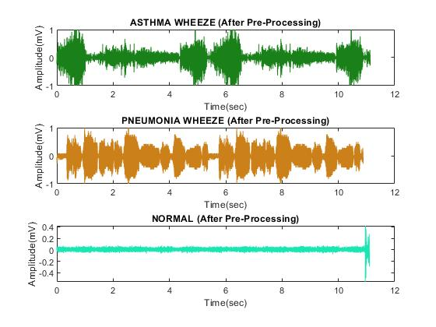
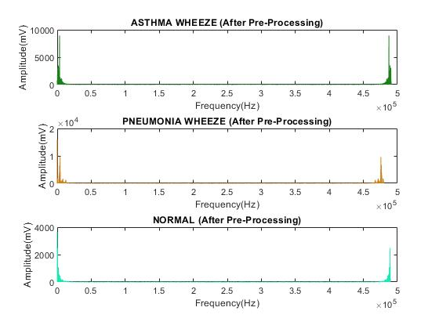
Lung Signal After Pre-processing
Frequency Domain Representation
Time Domain Representation

Slide 20

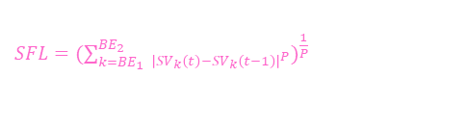
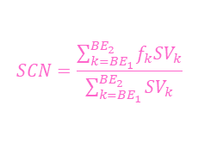
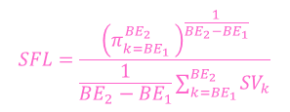
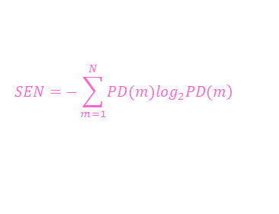
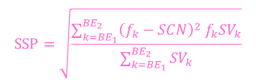
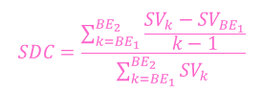
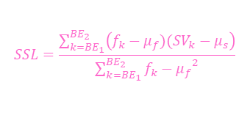
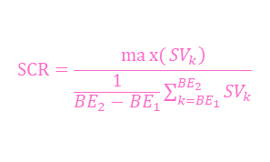
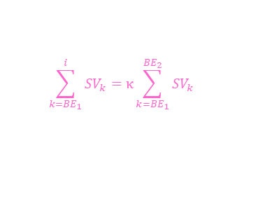
Feature Extraction
$$SSP=\sqrt{\frac{\sum_{k={BE}_{1}}^{{BE}_{2}}{{{\left(f_{k}−SCN\right)}^{2} f}_{k}{SV}_{k}}}{\sum_{k={BE}_{1}}^{{BE}_{2}}{{SV}_{k}}}}$$
Spectral Spread
9
Frequency gap around its centroid, and is related
to the bandwidth.
Spectral Centroid
1
2
Spectral Crest
Indicates where the center of mass of the spectrum is located.
Good predictor of the "brightness" of a sound
Known as peak component
Calculates signal quality
Ratio of a signal's peak value to the RMS
$$SCN=\frac{\sum_{k={BE}_{1}}^{{BE}_{2}}{f_{k}{SV}_{k}}}{\sum_{k={BE}_{1}}^{{BE}_{2}}{{SV}_{k}}}$$
$$SCR=\frac{\left.max{(}{SV}_{k}\right)}{\frac{1}{{BE}_{2}−{BE}_{1}}\sum_{k={BE}_{1}}^{{BE}_{2}}{{SV}_{k}}}$$
Spectral Decrease
3
4
Spectral Entropy
Tells average spectral slope
Useful in retrieving low frequency information
Gives information about signal’s irregularity, complexity or amount of disorder
$$SDC=\frac{\sum_{k={BE}_{1}}^{{BE}_{2}}{\frac{{SV}_{k}−{SV}_{{BE}_{1}}}{k−1}}}{\sum_{k={BE}_{1}}^{{BE}_{2}}{{SV}_{k}}}$$
$$SEN=−\sum_{m=1}^{N}{\left.PD(m)\log_{2}PD(m\right)}$$
Spectral Flatness
5
6
Spectral Flux
Measure of ratio of Arithmetic and Geometric mean of a signal powers spectrum
It is a measure of how quickly the power spectrum of a signal is changing,
$$SFL=\frac{{\left(π_{k={BE}_{1} }^{{BE}_{2}}\right)}^{\frac{1}{{BE}_{2}−{BE}_{1}}}}{\frac{1}{{BE}_{2}−{BE}_{1}}\sum_{k={BE}_{1}}^{{BE}_{2}}{{SV}_{k}}}$$
8
7
${SFL=(\sum_{k={BE}_{1}}^{{BE}_{2}}{ _{{\left|{SV}_{k}\left(t\right)−{SV}_{k}\left(t−1\right)\right|}^{P}}})}^{\frac{1}{P}}$
Spectral slope
Spectral Roll Off
It is a calculation of how quickly the spectrum of an audio sound swings towards the high frequencies
Tells the frequency in power spectrum of signal below which 85% of the spectral magnitude is situated
$$SSL=\frac{\sum_{k={BE}_{1}}^{{BE}_{2}}{\left(f_{k}−μ_{f})({SV}_{k}−μ_{s}\right)}}{\sum_{k={BE}_{1}}^{{BE}_{2}}{{f_{k}−μ_{f}}^{2}}}$$
$$\sum_{k={BE}_{1}}^{i}{{SV}_{k}}=κ\sum_{k={BE}_{1}}^{{BE}_{2}}{{SV}_{k}}$$

Slide 21
Classification
Supervised learning
01
Analyze data used for classification and regression analysis.
06
Support Vector Machine (SVM)
02
It has a regularisation parameter, which makes the user think about avoiding over-fitting.
Performs linear classification
For non-linear classification use the kernel trick
05
03
Works well with even unstructured and semi structured data like text, Images and trees.
04
Separates data by developing hyper planes.

Slide 22
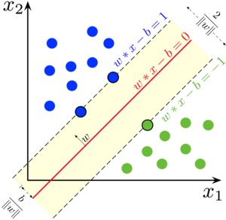
Support Vectors
Hyper Plane

Slide 23
RESULT AND DISCUSSION

Slide 24
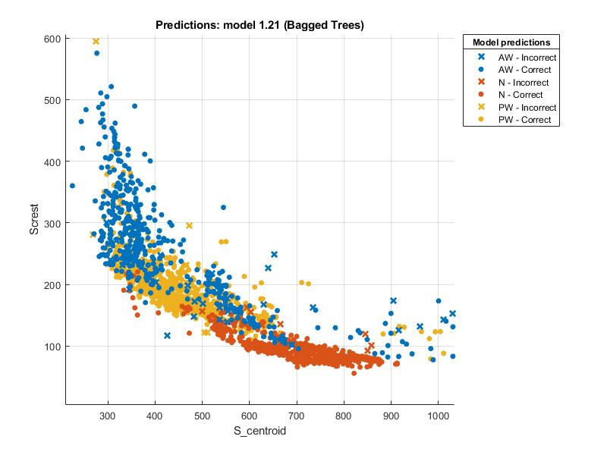
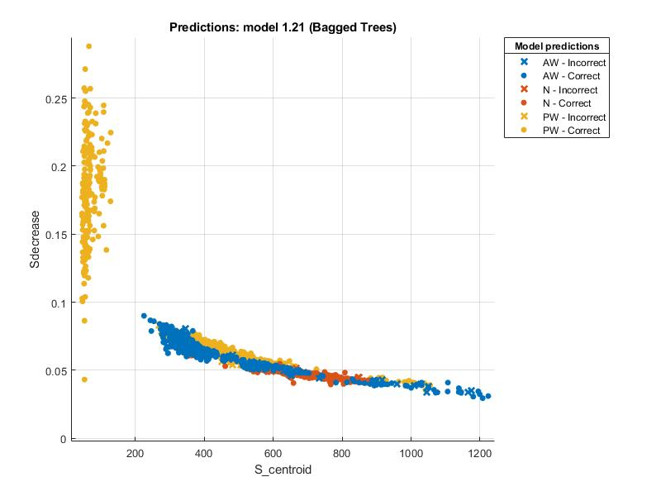
Scatter Plots
A) Spectral Centroid VS Spectral Crest
B) Spectral Centroid VS Spectral Decrease

Slide 25
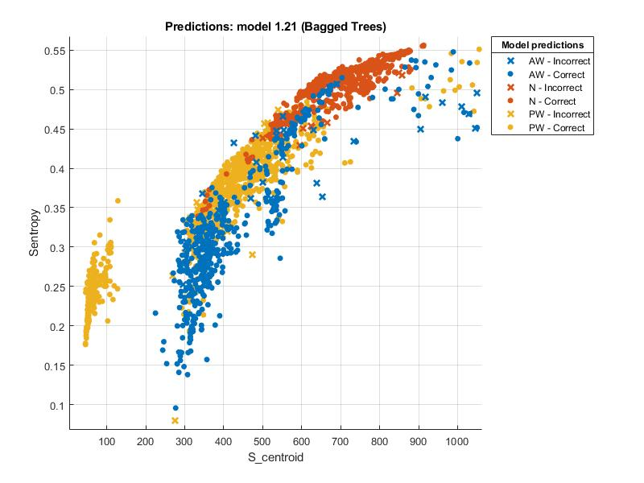
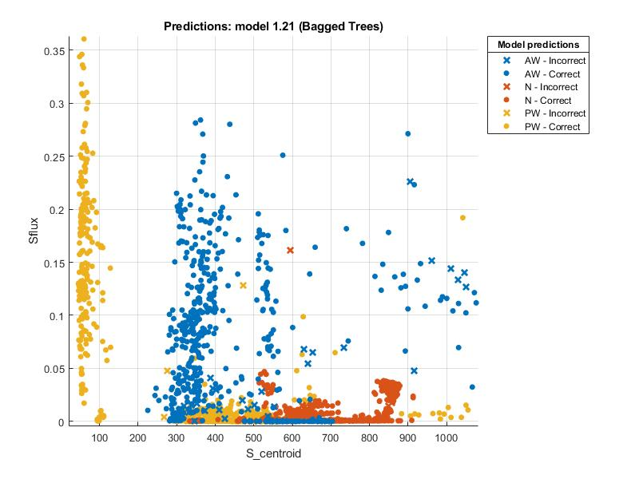
Scatter Plots
C) Spectral Centroid VS Spectral Entropy
D) Spectral Centroid VS Spectral Flux

Slide 26
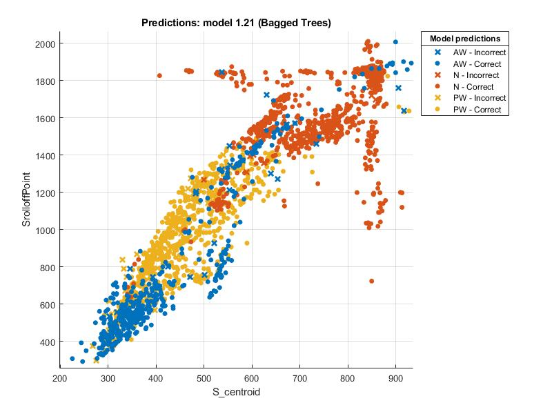
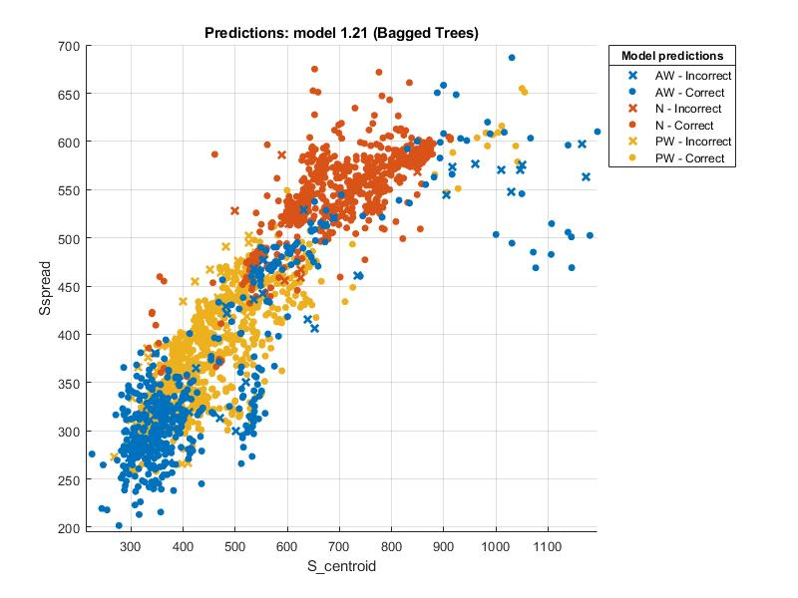
Scatter Plots
F) Spectral Centroid VS Spectral Spread
E) Spectral Centroid VS Spectral Rolloffpoint

Slide 29
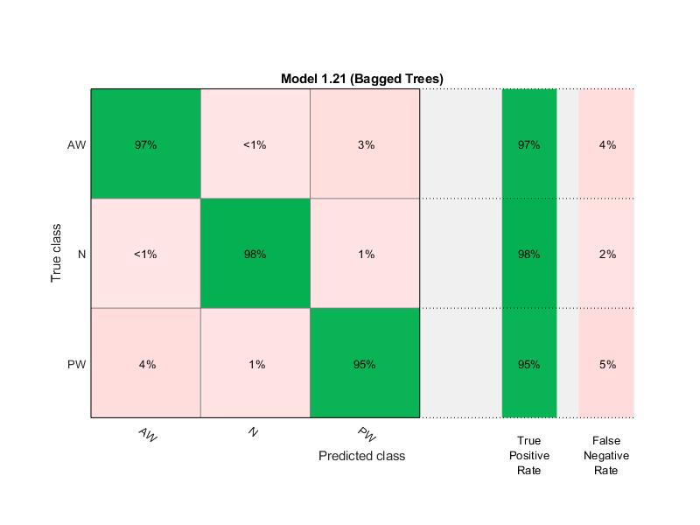

Confusion Matrix
5-fold K-cross validation

Slide 30
Comparative Analysis
S.No | Year | Data Acquisition | Classes & No of Samples | Feature Extraction | Classifier | Accuracy
1. | 2015 | Auscultating lung sounds by 3M Littman Stethoscope | Asthma Wheeze (32) Normal (26) | Spectrogram | BPNN | 94.6%
2. | 2016 | Auscultating lung sounds by electronic Stethoscope | Wheeze (12) Normal (12) | MFCC | SVM | 92%
3. | 2017 | Auscultating lung sounds by Electronic auscultation | Normal (48) Wheeze (24) Rhonchi (24) Coarse Crackles (24) | ARC MFCC | SVM | 88.72%to 89.68%
4. | 2018 | Auscultating lung sounds by Battery-powered sensor system | Asthma Wheeze (14) Normal (20) | STFT | Hidden Markov Model | 94.91%
5. | 2019 | Auscultating lung sounds by electronic Stethoscope | Monophonic Wheeze Polyphonic Wheeze Normal | Mel-frequency Cepstrum Dyadic Discrete Wavelet Transform Peak Energy Ratio | EML SVM KNN | 82.9% to 86%
This Research Methodology | 2020 | Lung Sounds by electronic microphone | Asthma Wheeze (1000) Pneumonia Wheeze (1000) Normal (1000) | Spectral Domain | Linear SVM | 96.7%

Slide 31
CONCLUSION

Slide 32
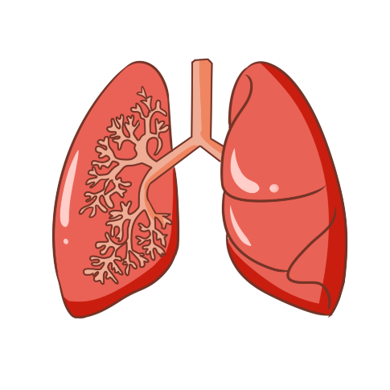
A new approach in field of Pulmonology
Effective
Cost Friendly
No danger to human health
Revolutionize medical diagnosis of lung diseases
Non-invasive signal acquisition technique
No radiation hazards
No training needed to operate this system
Automated detection of pulmonary disorders
(Wheezing in Asthma & Pneumonia patients)

Slide 33
REFRENCES

Slide 34
References
[1]
G. D’Amato et al., "Asthma-related deaths," vol. 11, no. 1, p. 37, 2016.
B.-S. Lin, H.-D. Wu, and S.-J. Chen, "Automatic wheezing detection based on signal processing of spectrogram and back- propagation neural network," Journal of healthcare engineering, vol. 6, no. 4, pp. 649-672, 2015.
[2]
[3]
O. Boujelben and M. Bahoura, "FPGA implementation of an automatic wheezes detector based on MFCC and SVM," in 2016 2nd International Conference on Advanced Technologies forSignal and Image Processing (ATSIP), 2016: IEEE, pp. 647- 650
R. Palaniappan, K. Sundaraj, and C. K. Lam, “Reliable system for respiratory pathology classification from Lungsound signals,” in 2016 International Conference on System Reliability and Science, ICSRS 2016 - Proceedings, Jan. 2017, pp. 152–156, doi: 10.1109/ICSRS.2016.7815855.
[4]
[5]
D. Oletic and V. Bilas, “Asthmatic Wheeze Detection from Compressively Sensed Respiratory Sound Spectra,” IEEE Journal of Biomedical and Health Informatics, vol. 22, no. 5, pp. 1406–1414, Sep. 2018, doi: 10.1109/JBHI.2017.2781135.
TS. Ulukaya, G. Serbes, and Y. P. Kahya, “Wheeze type classification using non-dyadic wavelet transform based optimal energy ratio technique,” Computers in Biology and Medicine, vol. 104, pp. 175–182, Jan. 2019, doi: 10.1016/j.compbiomed.2018.11.004.
[6]

Slide 35
Thank You

Slide 36


